Slide 1
C Programming
Dennis Ritchie
Presented by
Modern Delhi Infotech

Slide 2

Let's start

Slide 3
List of Program
Group-I
Write a program in c to print the name and address.
Write a program in c to add three number and display the sum.
Write a program in c to take two number and display the difference.
Write a program in c to take two number and display the product.
Write a program in c to take two number and display the remainder and quotient.
Write a program in c to enter two number and display the sum, difference, product, remainder, quotient.

Slide 4
Group-I
Basic Program
We will learn priintf(),declaration of variable
Initialization of variable

Slide 5
Write a program in c to print the name and address.
#include<stdio.h>
#include<conio.h>
void main()
{
printf(“Modern Delhi Infotech\n”);
printf(“SBI Road Madhepura ”);
getch();
}

Slide 6
Write a program in c to add three number and display the sum.
#include<stdio.h>
#include<conio.h>
void main()
{
int n1,n2,n3,sum;
n1=10;
n2=20;
n3=30;
sum=n1+n2+n3;
printf(“Sum of three Number=%d”,sum);
getch();
}
//declaration of variable
//Initialization of variable

Slide 7
Write a program in c to take two number and display the difference.
#include<stdio.h>
#include<conio.h>
void main()
{
int n1,n2,dif;
n1=50;
n2=20;
dif=n1-n2;
printf(“Difference =%d”,dif);
getch();
}

Slide 8
Write a program in c to take two number and display the Product.
#include<stdio.h>
#include<conio.h>
void main()
{
int n1,n2,product;
n1=50;
n2=20;
product=n1*n2; // * symbol is used for multiplication
printf(“Product =%d”,product);
getch();
}

Slide 9
Write a program in c to take two number and display the remainder and quotient.
#include<stdio.h>
#include<conio.h>
void main()
{
int num,rem,q;
num=23;
rem=num%3;
q=num/3;
printf("Remainder=%d",rem);
printf("\n Quotient=%d",q);
getch();
}
Output
Remainder=2
Quotient=7

Slide 10
Write a program in c to enter two number and display the sum, difference, product, remainder, quotient
#include<stdio.h>
#include<conio.h>
void main()
{
int n1,n2,sum,product,dif,rem,q;
n1=10;
n2=5;
sum=n1+n2;
dif=n1-n2;
product=n1*n2;
rem=n1%n2;
q=n1/n2;
printf("sum=%d\n Diff=%d\n Product=%d\n remainder=%d\n Quotient=%d",sum,dif,product,rem,q);
getch();
}

Slide 11
Group-II
Program using if-else statement
Scanf()
if else
else if()

Slide 12
Group-II
write a program in c accept the roll, name of student, address and marks and display it.
Write a program in c to accept two number from the user and display the sum, difference, product, remainder, quotient.
using if-else
write a program in c to accept a number check it odd or even.
Write a program in c accept a number and check it number is negative or positive.
write a program for enter the age of voter and check it he/she is eligible for voting or not
{hint: if age is greater or equal to 18 then voter is eligible for voting}
write a program for enter the marks of all subject and display the obtained marks, Percentage, division. {subject like- Phy, Chem, Math, Eng, Hindi}
Write a program in c accept two number and compare number which number is greater .
Write a program in c display the greatest number among three number

Slide 13
Group-II
Write a program in c accept a number and display the sum of digit
Write a program in c accept a number and display the reverse of number.
Write a program in c accept a number and check it number is palindrome or not.
Write a program in c accept a number and display the factorial.

Slide 14
write a program in c accept the roll, name of student, address and marks and display it.
#include<stdio.h>
#include<conio.h>
#include<string.h>
void main()
{
int roll,marks;
char name[20],add[20];
printf("Enter the roll=");
scanf("%d",&roll);
printf("Enter the name=");
scanf("%s",name);
printf("Enter the address");
scanf("%s",add);
printf("Enter the Mark =");
scanf("%d",&marks);
printf("Your Roll No=%d\nName%s\nAddress=%s\nMarks=%d",roll,name,add,marks);
getch();
}
%s format specifier is used for string
String: sets of characters

Slide 15
Write a program in c to accept two number from the user and display the sum, difference, product, remainder, quotient.
#include<stdio.h>
#include<conio.h>
void main()
{
int n1,n2,sum,product,dif,rem,q;
printf("Enter first number");
scanf("%d",&n1);
printf("Enter second number");
scanf("%d",&n2);
sum=n1+n2;
dif=n1-n2;
product=n1*n2;
rem=n1%n2;
q=n1/n2;
printf("sum=%d\n Diff=%d\n Product=%d\n remainder=%d\n Quotient=%d",sum,dif,product,rem,q);
getch();
}

Slide 16
write a program in c to accept a number check it odd or even.
#include<stdio.h>
#include<conio.h>
void main()
{
int num;
printf("Enter number which you want to check odd or even= ");
scanf("%d",&num);
if(num%2==0)
{
printf("Number is even");
}
else
{
printf("Number is odd");
}
getch();
}

Slide 17
write a program in c to accept a number check it negative or positive.
#include<stdio.h>
#include<conio.h>
void main()
{
int num;
printf("Enter number which you want to check odd or even= ");
scanf("%d",&num);
if(num>0)
{
printf("Number is Positive");
}
else if(num<0)
{
printf("Number is negative");
}
else
{
printf("Number is zero");
}
getch();
}

Slide 18
write a program for enter the age of voter and check it he/she is eligible for voting or not
{hint: if age is greater or equal to 18 then voter is eligible for voting}
#include<stdio.h>
#include<conio.h>
void main()
{
int age;
printf("Enter the age of voter");
scanf("%d",&age);
if(age>=18)
{
printf("You are eligible for voting");
}
else
{
printf("Your are not eligible for voting");11111
}
}
Eligibility criteria age must be greater than or equal to 18

Slide 19
write a program for enter the marks of all subject and display the obtained marks, Percentage, division. {subject like- Phy, Chem, Math, Eng, Hindi}
#include<stdio.h>
#include<conio.h>
void main()
{
int phy,chem,math,eng,hindi,total,per;
printf("Enter the Chemistry Marks=");
scanf("%d",&chem);
printf("Enter the Physics Marks=");
scanf("%d",&phy);
printf("Enter the Mathematics Marks=");
scanf("%d",&math);
printf("Enter the English Marks=");
scanf("%d",&eng);
printf("Enter the Hindi Marks=");
scanf("%d",&hindi);
total=phy+chem+math+eng+hindi;
per=total/5;
if(total>=300)
{
printf("First Division");
}
else if(total>=224 && total<300)
{
printf("second Division");
}
else if(total>=150 && total<225)
{
printf("Third Division");
}
else
{
printf("Fail");
}
getch();
}

Slide 20
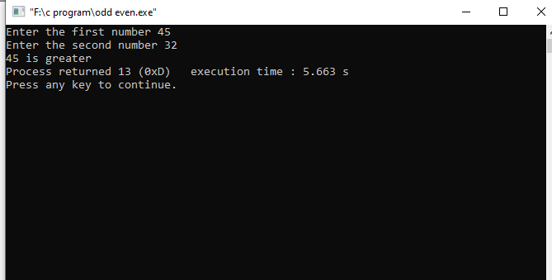
Write a program in c accept two number and compare number which number is greater .
#include<stdio.h>
#include<conio.h>
void main()
{
int n1,n2;
printf("Enter the first number");
scanf("%d",&n1);
printf("Enter the second number");
scanf("%d",&n2);
if(n1>n2)
{
printf("%d is greater",n1);
}
else
{
printf("%d is greater",n2);
}
}

Slide 21
Write a program in c display the greatest number among three number greater .
#include<stdio.h>
#include<conio.h>
void main()
{
int n1,n2,n3;
printf("Enter the first number ");
scanf("%d",&n1);
printf("Enter the second number ");
scanf("%d",&n2);
printf("Enter the third number ");
scanf("%d",&n3);
if(n1>n2&&n1>n3)
{
printf("%d is greater",n1);
}
else if(n2>n3&&n2>n1)
{
printf("%d is greater",n2);
}
else
{
printf("%d is greater ",n3);
}
}

Slide 22
Write a program in c accept a number and display the sum of digit
#include<stdio.h>
#include<conio.h>
void main()
{
int n,rem,sum=0,temp;
printf("Enter the number");
scanf("%d",&n);
temp=n;
while(temp!=0)
{
rem=temp%10;
sum=sum+rem;
temp=temp/10;
}
printf("sum of %d digit is = %d",n,sum);
}
Sum of digit of 325
Sum=3+2+5
Sum=10

Slide 23
Write a program in c accept a number and display the reverse of number.
#include<stdio.h>
#include<conio.h>
void main()
{
int n,rem,rev=0,temp;
printf("Enter the number");
scanf("%d",&n);
temp=n;
while(temp!=0)
{
rem=temp%10;
rev=rev*10+rem;
temp=temp/10;
}
printf("reverse of %d is = %d",n,rev);
}
Num= 325
Reverse=523

Slide 24
Write a program in c accept a number and check it number is palindrome or not.
#include<stdio.h>
#include<conio.h>
void main()
{
int n,rem,rev=0,temp;
printf("Enter the number");
scanf("%d",&n);
temp=n;
while(temp!=0)
{
rem=temp%10;
rev=rev*10+rem;
temp=temp/10;
Example:
121 is palindrome number because its reverse number is same(121) as previous number
Rest part will be in next slide

Slide 25
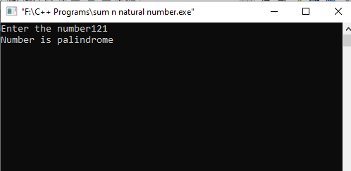
if(rev==n)
{
printf("Number is palindrome");
}
else
{
printf("Number is not palindrome");
}
getch();
}
Output

Slide 26
Write a program in c accept a number and display its factorial
#include<stdio.h>
#include<conio.h>
void main()
{
int num,fact,i;
printf("Enter the number");
scanf("%d",&num);
fact=1;
for(i=1;i<=num;i++)
{
fact=fact*i;
}
printf("factorial of %d is =%d",num,fact);
getch();
}
Factorial 5
5X4X3X2X1=120

Slide 27
Group-III
Loop Concept
All program will be based on loop
While loop
Do while
For loop

Slide 28
Group-III
Using Loop
Write a program in c display the 10 time “India is Great”.
Write a program in c display the 10-natural number from 1 to 10 in ascending order.
Write a program in c display the 10-natural number from 10 to 1 in descending order.
Write a program in c display the sum of 10 natural number.
Write a program in c display the sum of n natural number.
Write a program in c accept the number and display the table of given number.
Write a program in c accept a number and check it number is prime or not

Slide 29
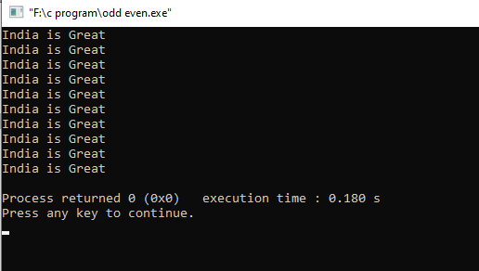
Write a program in c display the 10 time “India is Great”.
#include<stdio.h>
#include<conio.h>
void main()
{
int i=0;
for(i=0;i<10;i++)
{
printf("India is Great \n");
}
}

Slide 30
Write a program in c display the 10-natural number from 1 to 10 in ascending order.
#include<stdio.h>
#include<conio.h>
void main()
{
int i;
for(i=1;i<=10;i++)
{
printf("%d \t",i);
}
getch();
}
Output
1
2
3
4
5
6
7
8
9
10

Slide 31
Write a program in c display the 10-natural number from 10 to 1 in descending order.
#include<stdio.h>
#include<conio.h>
void main()
{
int i;
for(i=10;i>=1;i--)
{
printf("%d \t",i);
}
getch();
}
Output
10
9
8
7
6
5
4
3
2
1

Slide 32
Write a program in c display the sum of 10 natural number.
#include<stdio.h>
#include<conio.h>
void main()
{
int i,sum=0;
for(i=1;i<=10;i++)
{
sum=sum+i;
}
printf("%d ",sum);
getch();
}
Sum of 10 natural number
1+2+3+4+5+6+7+8+9+10=55

Slide 33
Write a program in c display the sum of n natural number.
#include<stdio.h>
#include<conio.h>
void main()
{
int i,n,sum=0;
printf("Enter the number=");
scanf("%d",&n);
for(i=1;i<=n;i++)
{
sum=sum+i;
}
printf(“sum of %d is =%d ",n,sum);
getch();
}
Output
Enter the number=5
Sum of 5 is =15

Slide 34
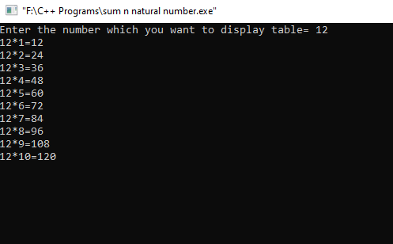
Write a program in c accept the number and display the table of given number.
#include<stdio.h>
#include<conio.h>
void main()
{
int n,i;
printf("Enter the number which you want to display table= ");
scanf("%d",&n);
for(i=1;i<=10;i++)
{
printf("%d*%d=%d\n",n,i,n*i);
}
getch();
}

Slide 35
Write a program in c accept the number check number is prime or not.
#include<stdio.h>
#include<conio.h>
void main()
{
int n,i,count=0;
printf("Enter the number which you want to check prime or not= ");
scanf("%d",&n);
for(i=2;i<n;i++)
{
if(n%i==0)
{
count++;
}
}
Rest part will be in next slide

Slide 36
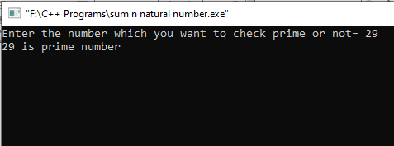
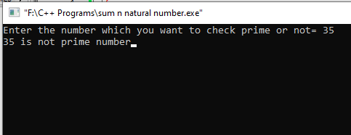
if(count==0)
{
printf("%d is prime number",n);
}
else
{
printf("%d is not prime number",n);
}
getch();
}
Output

Slide 37
Thank You

